Slide 1
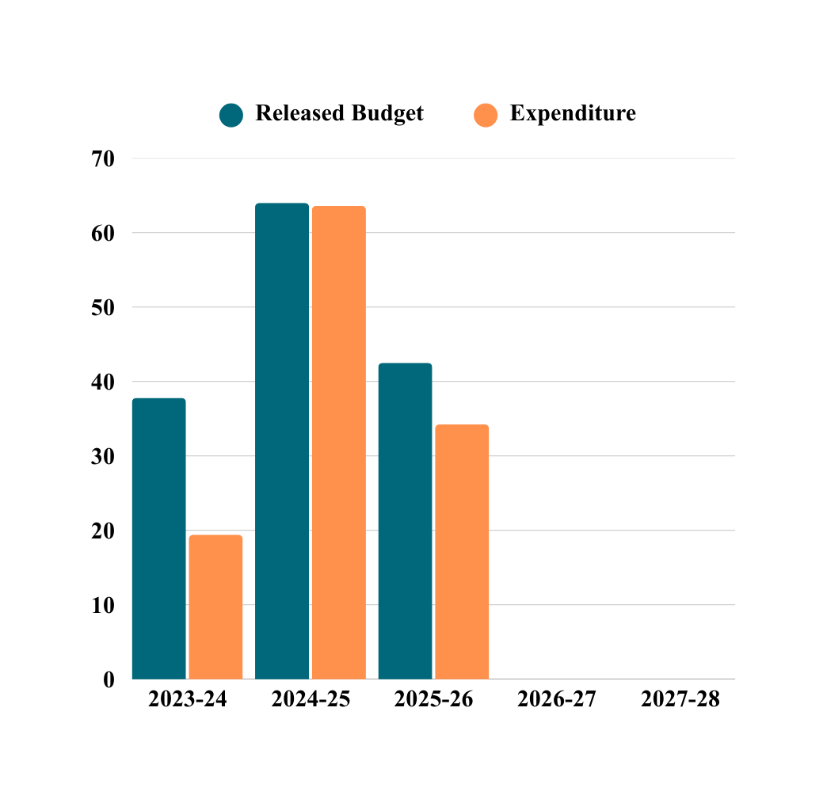
FINANCIAL PROGRESS IN LACS

